Slide 1





Automated Game-Theoretic Security Analysis of Blockchain Protocols
The 12th Workshop on Formal Reasoning in Distributed Algorithms (FRIDA25)
October 27 2025
Ivana Bocevska
Lea Salome Brugger
Laura Kovács
Anja Petković Komel
Sophie Rain
Michael Rawson

Slide 2


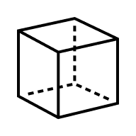




Blockchains and their Protocols
provides cryptocurrency
security analysis of blockchain protocols
rely on punishment mechanisms
blockchain
track balances
enables decentralized finance
protocols
(sets of rules)
auctions, crowdfunding,…
popular target for attacks

Slide 3







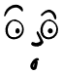

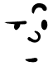









Aspects of Security
implementation
cryptographic concepts
incentive structures
What happens when I type
my password in?
Can a malicious person steal my password?
Do I want to share my password?
Implementation Security
Cryptographic Security
Game-Theoretic Security

Slide 4











Aspects of Security
implementation
cryptographic concepts
incentive structures
What happens when I type
my password in?
Can a malicious person steal my password?
Do I want to share my password?
Implementation Security
Cryptographic Security
Game-Theoretic Security

Slide 5





Outline
Automated Game-Theoretic Security Analysis of Blockchain Protocols
Automated Security Analysis of Blockchain Protocols
Automated Game-Theoretic Security Analysis of Blockchain Protocols
Automated Game-Theoretic Security Analysis of Blockchain Protocols
Automated Game-Theoretic Security Analysis of Blockchain Protocols
Automated Game-Theoretic Security Analysis of Blockchain Protocols
Automated Game-Theoretic Security Analysis of Blockchain Protocols
?
game modeling
security analysis
[CSF23]
[CSF23]
[iFM25]
[CCS23]
[LPAR24]
[OOPSLA25]

Slide 6




Game-Theoretic Modeling
?
game modeling
security analysis
[CSF23]
[CSF23]
[iFM25]
[CCS23]
[LPAR24]
[OOPSLA25]

Slide 7
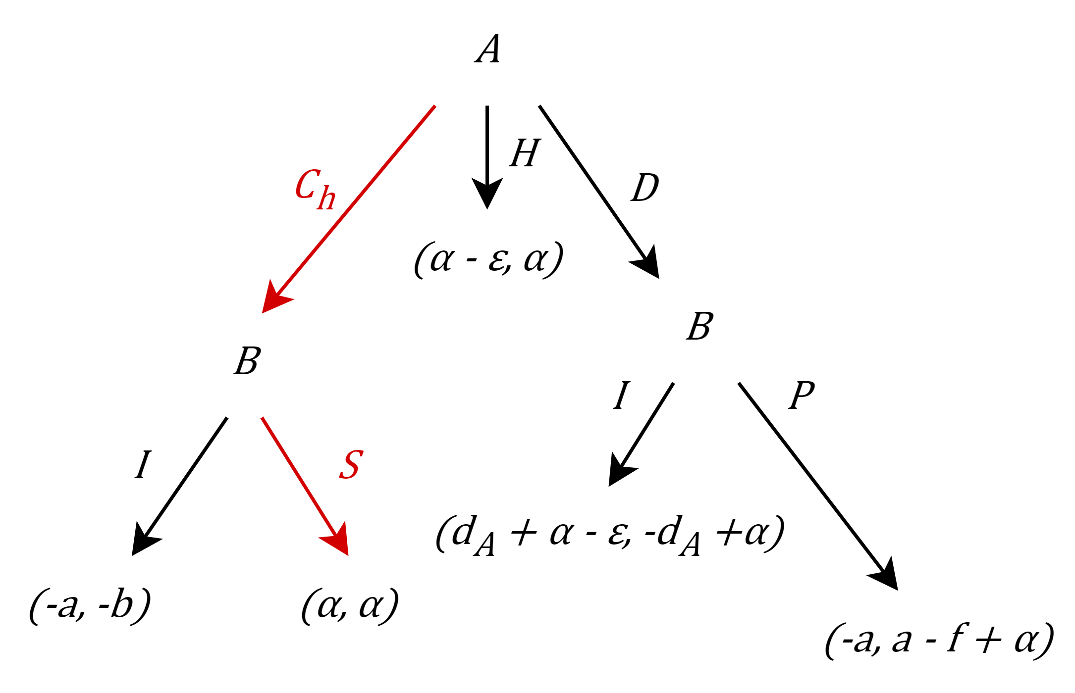
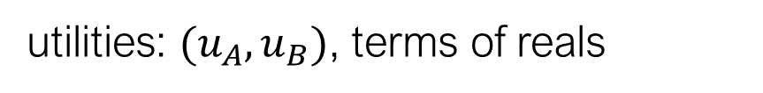
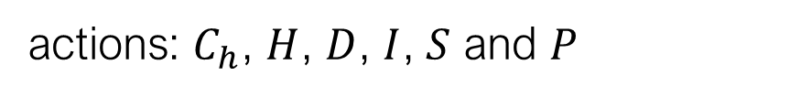
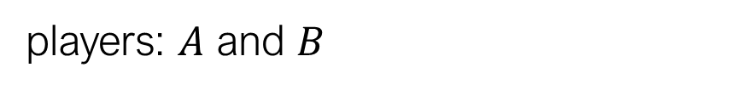
Game-Theoretic Models
Game Theory
[CSF23]
players: $A$ and $B$
actions: $C_{h}$, $H$, $D$, $I$, $S$ and $P$
utilities: $(u_{A}, u_{B})$, terms of reals
joint strategy: one action per node
honest behavior: intended scenario
Simplified Closing Game

Slide 8
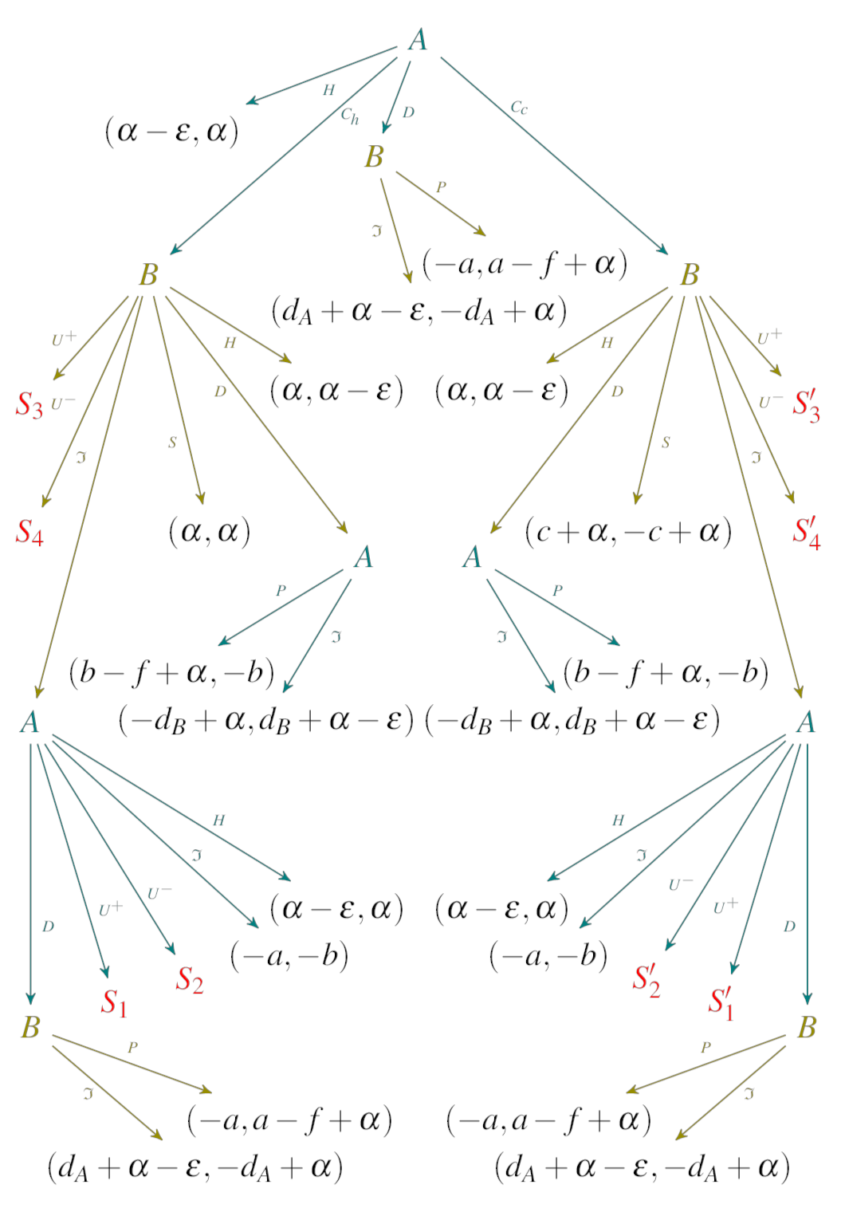
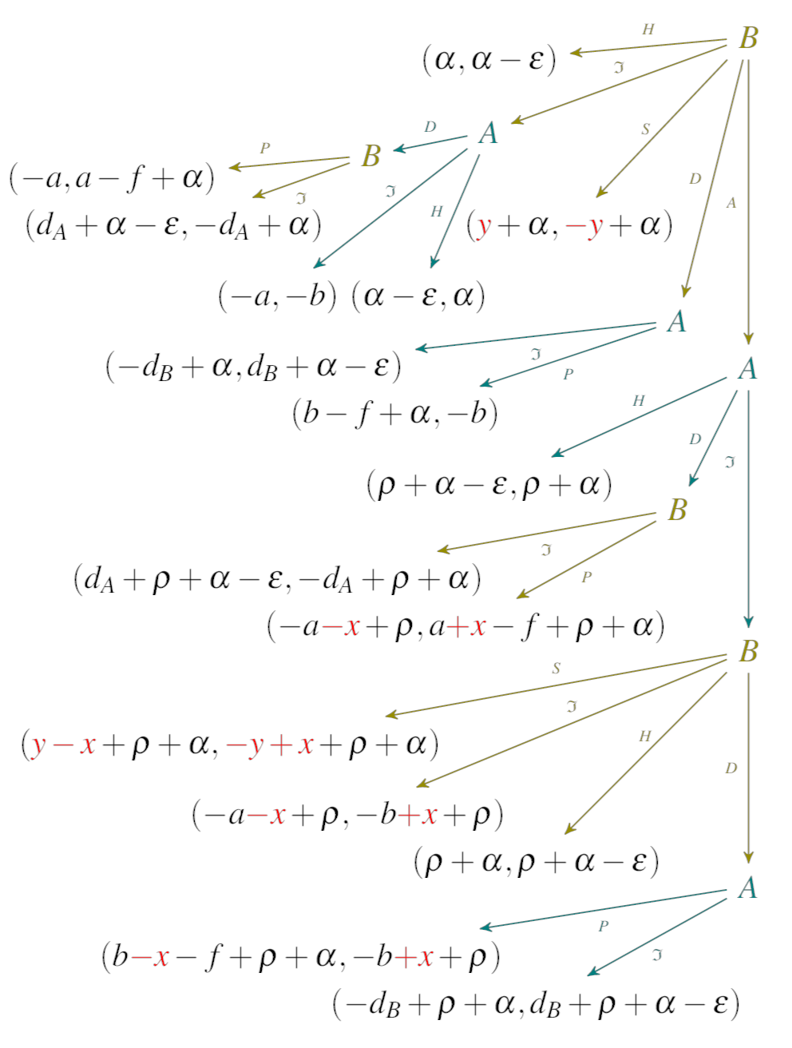
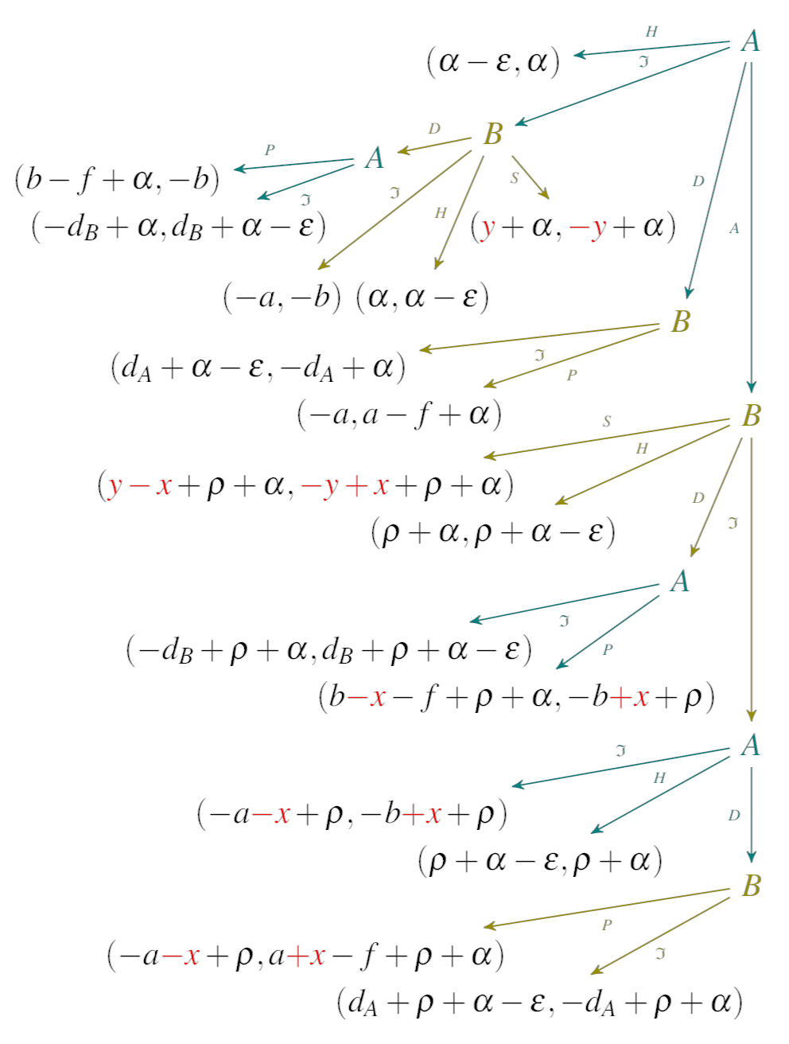
Blockchain Protocols as Games
Game Theory
[CSF23]
trillions of joint strategies
Closing Game

Slide 9

Security Analysis
?
game modeling
security analysis
[CSF23]
[CSF23]
[iFM25]
[CCS23]
[LPAR24]
[OOPSLA25]

Slide 10










Verifying Game-Theoretic Models
Security Reasoning
[CSF23]
1. Incentive Compatibility (IC) honest behavior always rational
1. Incentive Compatibility (IC) honest behavior always rational
2. Byzantine Fault Tolerance (BFT) honest players never harmed
2. Byzantine Fault Tolerance (BFT) honest players never harmed
=
=
honest
rational
Byzantine

Slide 11
Verifying Game-Theoretic Models
Security Reasoning
[CSF23]
1. Incentive Compatibility (IC) honest behavior always rational
1. Incentive Compatibility (IC) honest behavior always rational
2. Byzantine Fault Tolerance (BFT) honest players never harmed
2. Byzantine Fault Tolerance (BFT) honest players never harmed
protocol is game-theoretically secure iff honest behavior satisifies IC and BFT

Slide 12



Security of Closing Game
Security Reasoning
[CSF23]
Is there an honest joint strategy that is …
incentive compatible?
Byzantine fault tolerant?
Is the honest behavior …
incentive compatible?
Byzantine fault tolerant?
trillions of joint strategies
Closing Game

Slide 13
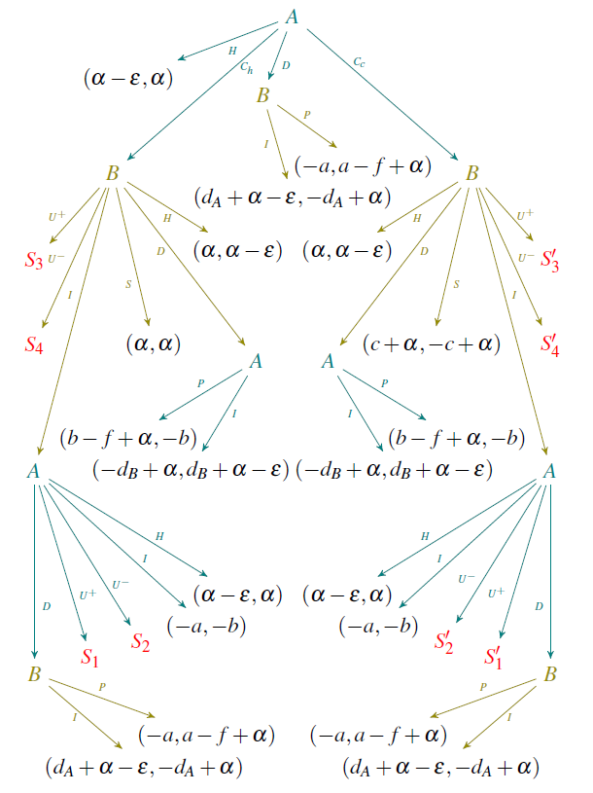
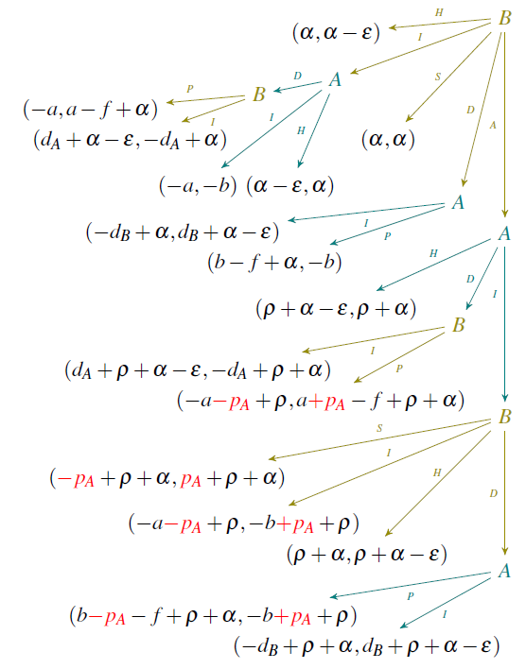
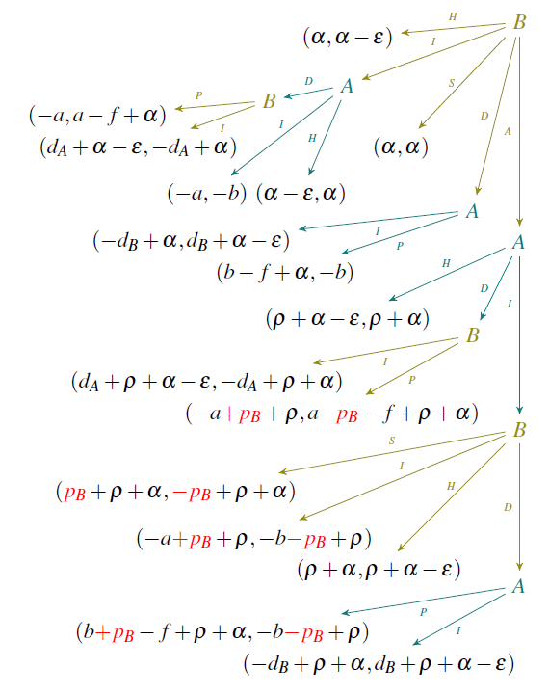
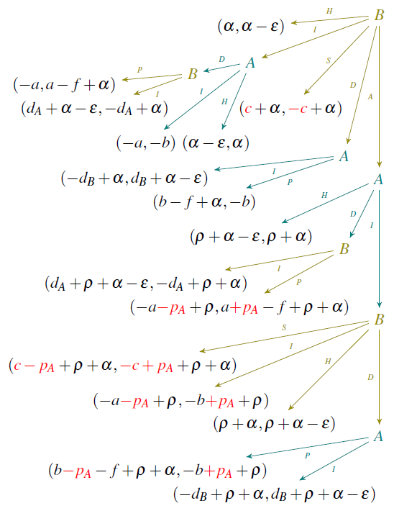
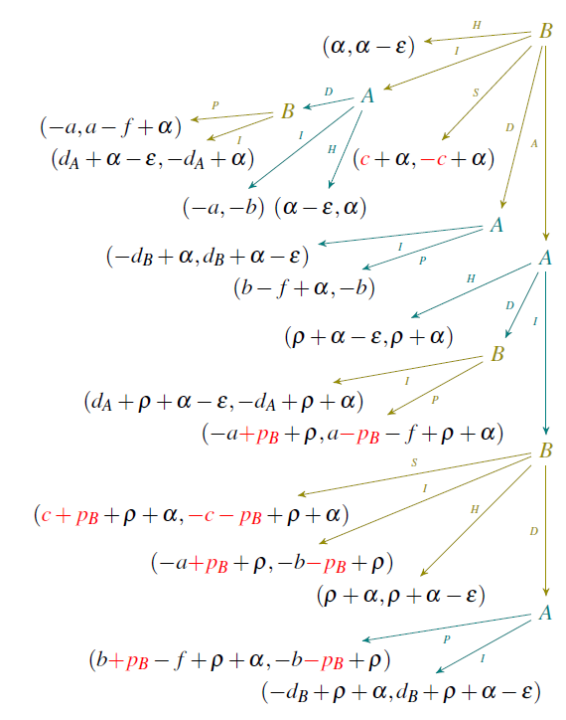
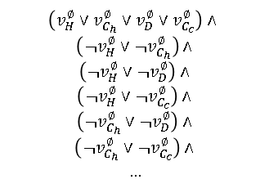
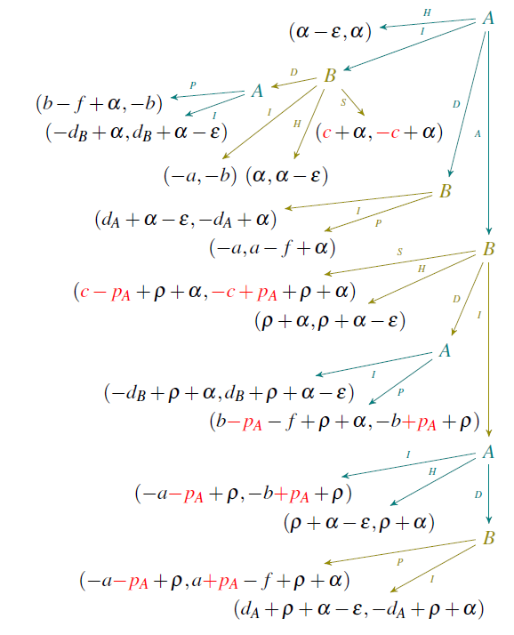





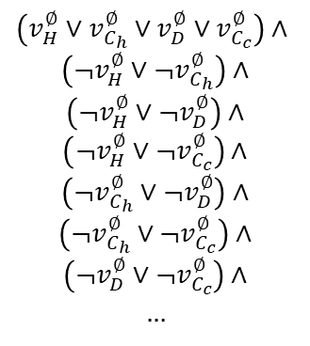
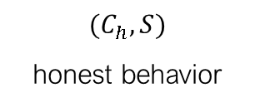
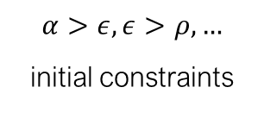
Automated Reasoning
CheckMate
[CCS23]
$$\left(v_{H}^{∅}∨v_{C_{h}}^{∅}∨v_{D}^{∅}∨v_{C_{c}}^{∅}\right)∧$$
$$\left(¬v_{H}^{∅}∨{¬v}_{C_{h}}^{∅}\right)∧$$
$$\left(¬v_{H}^{∅}∨{¬v}_{D}^{∅}\right)∧$$
$$\left(¬v_{H}^{∅}∨{¬v}_{C_{c}}^{∅}\right)∧$$
$$\left(¬v_{C_{h}}^{∅}∨{¬v}_{D}^{∅}\right)∧$$
$$\left(¬v_{C_{h}}^{∅}∨{¬v}_{C_{c}}^{∅}\right)∧$$
$$\left(¬v_{D}^{∅}∨{¬v}_{C_{c}}^{∅}\right)∧$$
$$…$$
strategy extraction
game
secure
sound and complete
$$α>ε, ε>ρ, …$$
initial constraints
precondition generation
$$(C_{h}, S)$$
honest behavior
SMT solver
SMT constraints
not secure
BFT security property
counterexample generation

Slide 14


Security of Closing Game (Revisited)
CheckMate
[LPAR24]
[LPAR24]
[CCS23]
[CCS23]
Is the honest behavior …
incentive compatible?
Byzantine fault tolerant?
trillions of joint strategies
CheckMate 0 (Prototype)
CheckMate 1.0
30 seconds execution time
0.3 seconds execution time
[LPAR24]
[CCS23]
Closing Game

Slide 15




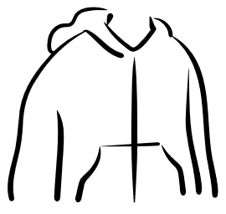


Compositional Approach
Compositionality
[OOPSLA25]
Level 1: Stratify over players
BFT for Alice*?
IC for Alice*?
BFT for Bob*?
IC for Bob*?
BFT?
IC?
BFT for Eve*?
IC for Eve*?
* Assuming the fixed player is honest

Slide 16
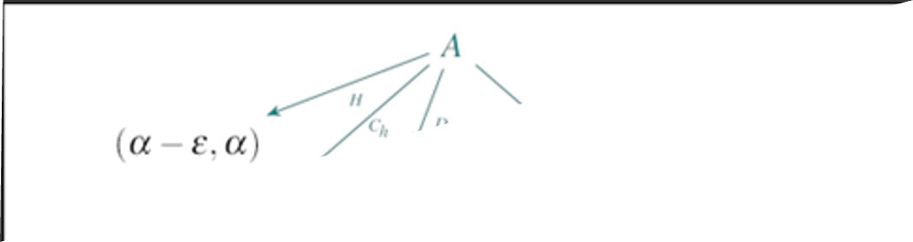
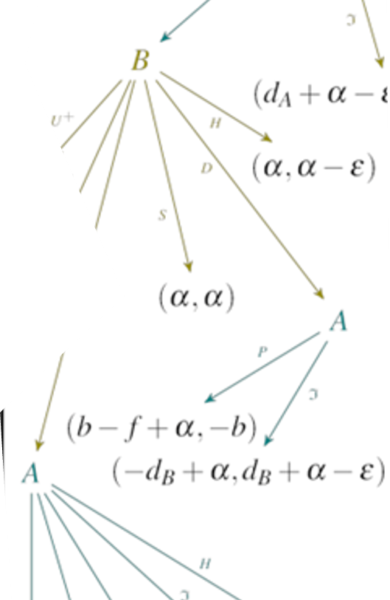
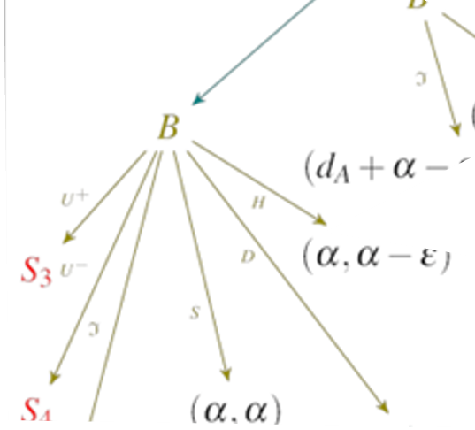



Compositional Approach
Compositionality
[OOPSLA25]
Level 2: Divide & Conquer Subtrees
BFT for Alice*?
IC for Alice*?
BFT for Alice*?
IC for Alice*?
BFT for Alice*?
IC for Alice*?
$$\bigwedge{/\bigvee{}}$$
$$\bigwedge{/\bigvee{}}$$
BFT for Alice*?
IC for Alice*?
…
…
$$\bigwedge{/\bigvee{}}$$
BFT for Alice*?
IC for Alice*?
BFT for Alice*?
IC for Alice*?

Slide 17
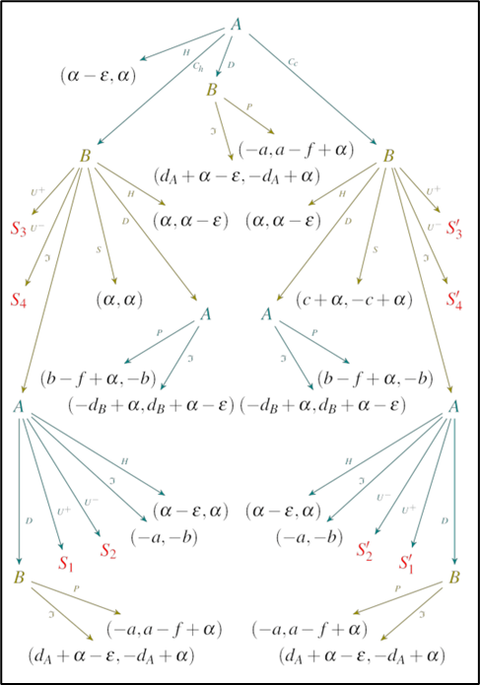

Compositional Approach
Compositionality
[OOPSLA25]
Piecewise Analysis
144,342,306 nodes
> 200 GB
Game tree

Slide 18
Compositional Approach
Compositionality
[OOPSLA25]
Piecewise Analysis

Slide 19


Compositional Approach
Compositionality
[OOPSLA25]
Piecewise Analysis
Subgame
CheckMate 2.0
Subgame security result
Supergame

Slide 20
Compositional Approach
Compositionality
[OOPSLA25]
Piecewise Analysis
Supergame

Slide 21

Compositional Approach
Compositionality
[OOPSLA25]
Piecewise Analysis
Supergame security result
Supergame
CheckMate 2.0

Slide 22
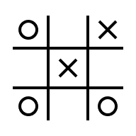


Experimental Evaluation
Compositionality
[Comp25]
[OOPSLA25]
CheckMate 1.0 [LPAR24]
TO after 8 hours
1 SMT call
548,946 evaluated nodes
CheckMate 2.0 [OOPSLA25]
42s execution time
10,694 SMT calls
18,036 evaluated nodes
548,946 nodes
50 min for all counterexamples
5 min for all counterexamples
21,688 nodes

Slide 23

Modeling
?
game modeling
security analysis
[CSF23]
[CSF23]
[iFM25]
[CCS23]
[LPAR24]
[OOPSLA25]

Slide 24




Modeling Principles for Game-Theoretic Security
Game Modeling
[iFM25]
Relative Utilities
Ghosting
Actual Choice

Slide 25

Game Modeling – Simplified Closing Game
Game Modeling
[iFM25]
Declare Assumptions and Design Choices
template & dsl
Define Players
Exhaust Parameter Options
Define a State
Define Final States
Define Utility Function
Collect Actions
Fix Player Precedence

Slide 26
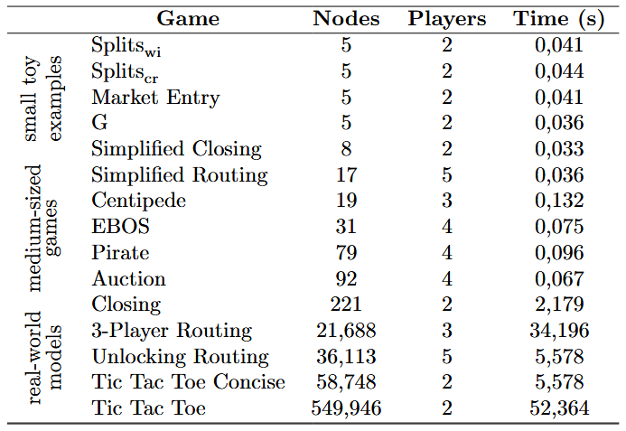
Game Modeling - Benchmarks
[CCS23]
Game Modeling
[CSF23]
[iFM25]
[OOPSLA25]
[LPAR24]
Strategies, Counterexamples, Weakest Preconditions in [OOPSLA25]

Slide 27

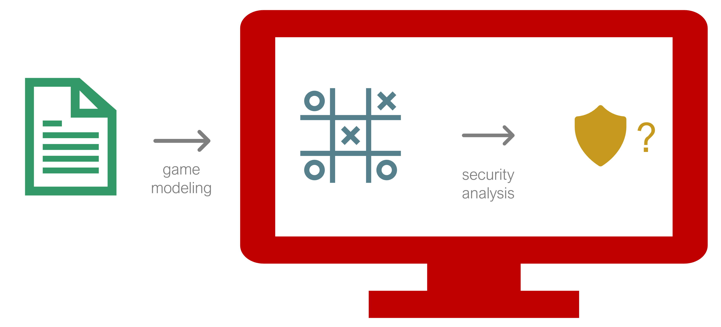
Questions?
[CCS23]
Ivana Bocevska
ivana.bocevska@tuwien.ac.at
Related Papers
[iFM25] | Game Modeling of Blockchain Protocols, S. Rain, A. Petković Komel, M. Rawson, L. Kovács
[OOPSLA25] | Divide and Conquer: a Compositional Approach to Game-Theoretic Security, I. Bocevska, A. Petković Komel, L. Kovács, S. Rain, M. Rawson
[LPAR24] | Scaling CheckMate for Game-Theoretic Security, S. Rain, LS. Brugger, A. Petković Komel, L. Kovács, M. Rawson
[CCS23] | CheckMate: Automated Game-Theoretic Security Reasoning, LS. Brugger, L. Kovács, A. Petković Komel, S. Rain, M. Rawson
[CSF23] | Towards a Game-Theoretic Security Analysis of Off-Chain Protocols, S. Rain, G. Avarikioti, L. Kovács, M. Maffei
CheckMate 2.0

